Slide 1
TEAM10-PROJECT BANKING

Slide 2
OBJECTIVE:
Online banking system is a web application which provides a user-friendly user interface and an easy efficient way to perform banking operations such as account creation, fund transfer, password reset.
A customer has access to update their details, transfer fund to other accounts, resetting passwords etc.
It provide an automation for banking system through Internet. The aim is not only automation but also a better customer experience by providing a User Interface which is easily comprehendible by any person

Slide 3
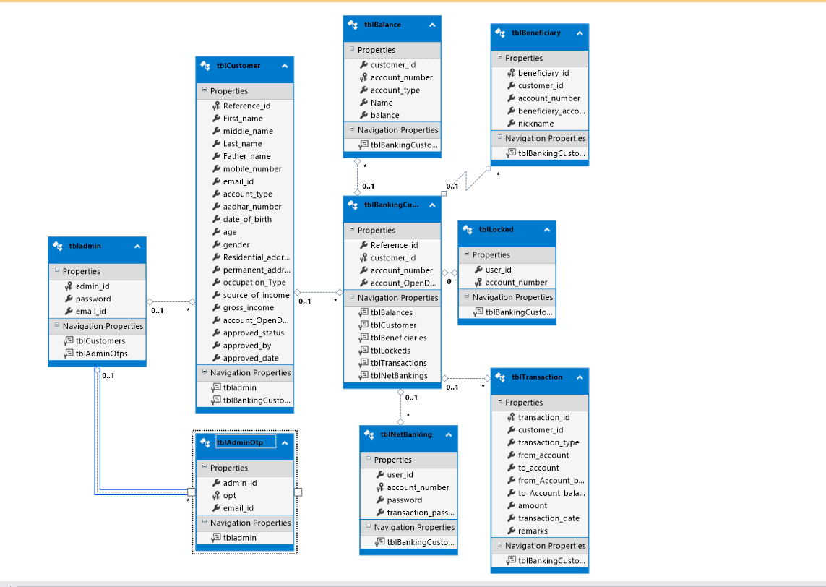
ER DIAGRAM

Slide 4
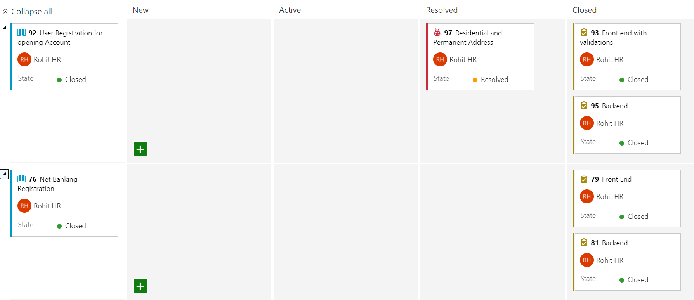
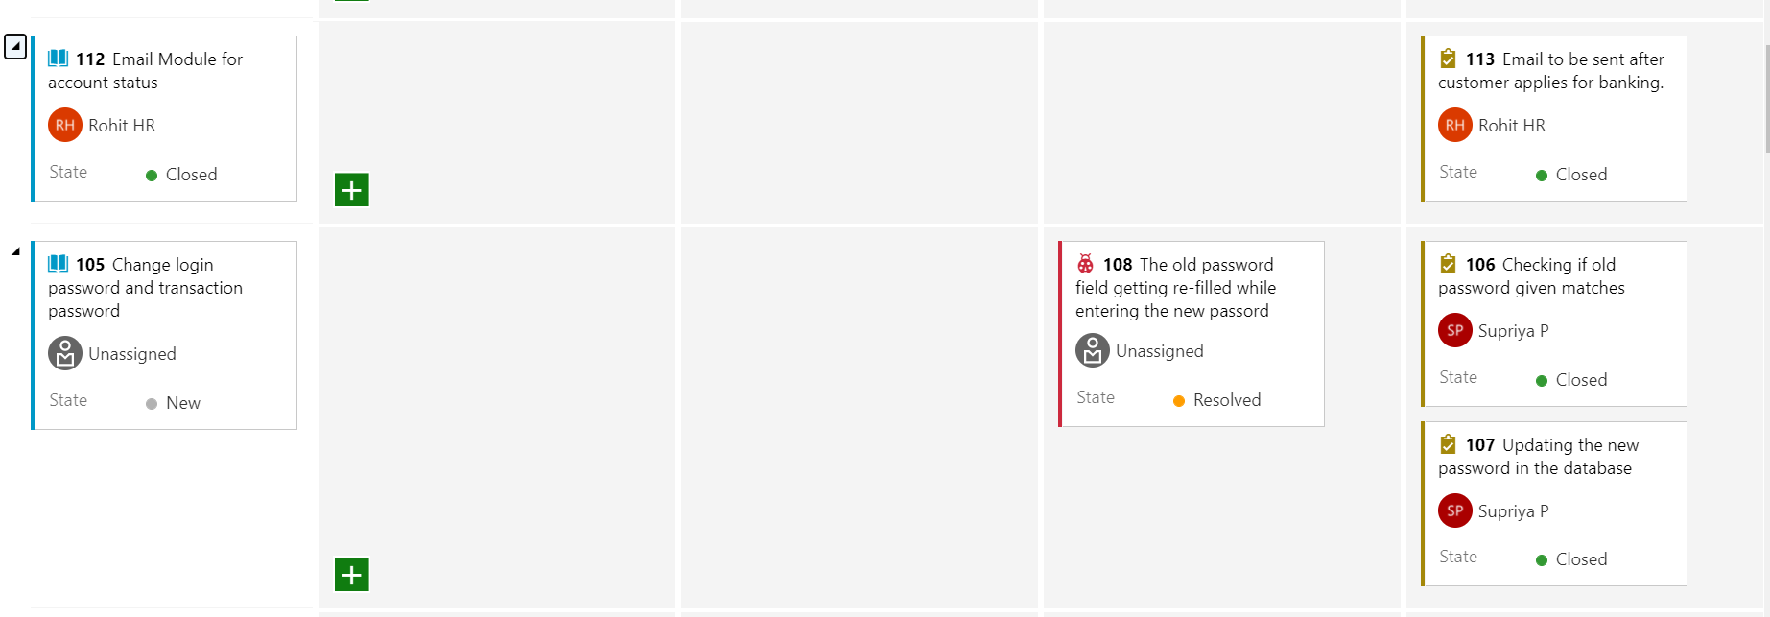

Slide 5
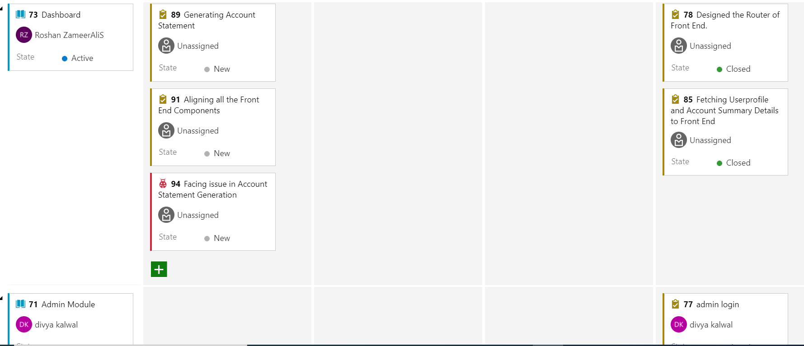
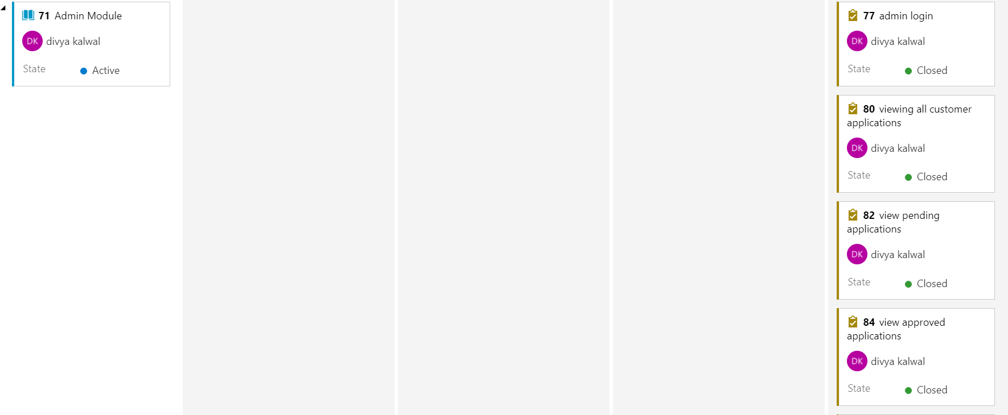

Slide 6
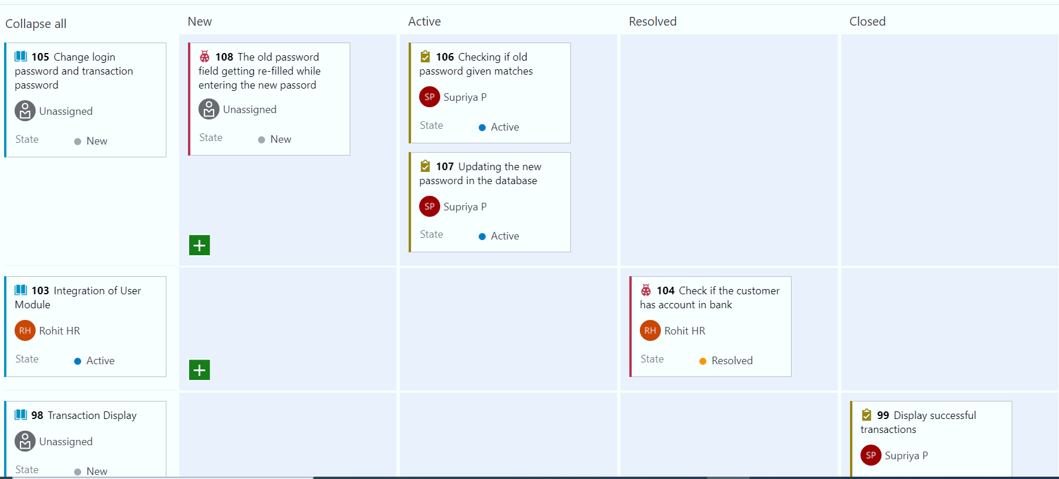
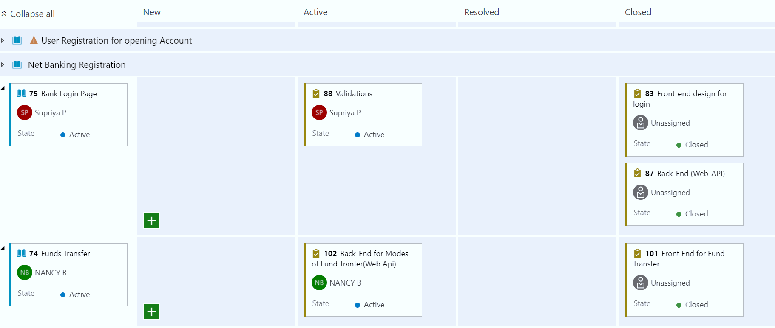

Slide 7
Issues we faced:
We found some routing issues after the integration of the sub-modules and we would be able resolve it.
we encountered with some errors while implementing the template driven and reactive forms .
We faced some connection issues from the angular to the WEBAPI while passing the data and resolved by passing the correct model of object.

Slide 8
What we explored
We implemented the AUTHGUARD and CANACTIVE method which will give access to the routes for the authenticated user .
We explored sending the mails to the user acknowledging the application status and implemented by using the SMTP mail.
We generated the OTP for the authentication of a valid customer so that they can change their password

